Slide 1
CSE7302 - INTERNSHIP Review-4 Presentation DATA ANALYTICS IN TEA PLANTATION BUSINESS OPERATIONS
Student Details
Name | PREETHA GUHA
Roll No | 20221CSE0271
Section | 8CSE10
Under the Supervision of,
Dr.Taranath N L
Associate Professor
Presidency School of CSE
Presidency University
Name of the Program: CSE7302- INTERNSHIP
Name of the HoD: Dr. Asif Mohammed
Name of the Program Internship Coordinator: Mr. Sakthi S
Name of the School Internship Coordinator: Dr. Md Ziaur Rahman

Slide 2
CONTENT
About Company or Organization
Working domain or the technology
About your team and reporting Manager
Challenges Faced in Internship
Objectives of the work
Literature Review
Proposed System
Problem Statement
Advantages of Proposed System/Work
System Requirements
System Design
System Implementation
Internship Roadmap
Github Link

Slide 3
About Bhardeswar Tea Plantation Company Private Limited
Bhardeswar Tea Plantation Company Private Limited was registered at Registrar of Companies Kolkata on 15 November, 1990 and is categorised as Company limited by Shares and an Non-govt company. The firm provides tea plantation with cultivation, processing and inventory management of the tea. Having more than 30 years of operating experience, the company abides by well-defined accounting, operational and compliance practices to optimize its business behaviors.
The company is based in Jalpaiguri, West Bengal and is active as a working organisation in the agriculture & plantation industry. It keeps extensive information on production, inventory, cost and sales that generate large quantity of operational and financial data. This data forms a solid basis for the application of data analytics methods to boost reporting, business insight and operational decision making.

Slide 4
About Bhardeswar Tea Plantation Company Private Limited
The company’s operations involve multiple functional areas such as plantation field activities, labor coordination, inventory control, accounting, and sales-related processes. These activities require regular monitoring and documentation to ensure smooth day-to-day operations and financial accuracy. The organization follows systematic record-keeping practices to support internal reviews, audits, and statutory compliance.
As a tea plantation business, the company operates in a seasonal production environment, where output, expenses, and sales vary across different periods of the year. This results in fluctuating operational and financial data, making structured data analysis and reporting important for understanding trends, managing costs, and improving operational efficiency. The availability of historical data provides opportunities to apply data analytics for better business insights and decision support.

Slide 5
Working domain or the technology
ASSIGNED DOMAIN
Data Analysis and Reporting in Tea Plantation Business
ROLE OF TECHNOLOGY IN THIS DOMAIN
Tally: Primary source of accounting, sales, and inventory data used for business operations
Microsoft Excel: Data cleaning, organization, management, and preparation of structured reports
Python: Supporting basic data validation, cleaning, and simple data processing tasks
FEATURES & IMPORTANCE OF THE ASSIGNED DOMAIN
Works with real tea plantation operational and financial data for analysis and reporting
Helps structure data to identify trends and support data-driven business decisions
Improves reporting efficiency and provides hands-on exposure to analytics tools

Slide 6
About my team and reporting Manager
The internship training is carried out under the guidance of the accounts and operations team of the tea plantation company.
During this phase, the team introduces the business structure, accounting workflow, and operational processes followed in the organization.
A senior staff member supervises the training activities and provides instructions and learning guidance.
The reporting structure involves regular interaction, monitoring, and clarification sessions with the reporting manager.
The team explains standard procedures followed for data entry, record maintenance, and reporting activities.
Training sessions focus on understanding data sources, documentation practices, and accuracy requirements.
The working environment supports learning, supervision, and gradual exposure to team-based activities during the training period.

Slide 7
Challenges Faced in Internship
Finding a suitable internship opportunity related to the academic domain and industry exposure
Understanding the tea plantation business environment and operational workflow
Learning to work with real accounting and operational data using tools like Tally
Adjusting to a professional work environment and understanding office procedures
Coordinating with team members and adapting to new roles and responsibilities
Ensuring data accuracy and following proper documentation and reporting standards

Slide 8
Literature Review
Previous studies and industry practices highlight the importance of data analytics in financial and operational decision-making. Research indicates that analysis of Balance Sheet and Profit & Loss data helps organizations understand profitability, cost structure, and financial stability. In many small and medium-scale organizations, accounting software such as Tally is widely used for maintaining financial records, vouchers, and statutory data.
Literature also shows that while Tally is effective for accounting and compliance, it offers limited analytical and visualization capabilities. Therefore, data extracted from Tally is often processed using tools such as Microsoft Excel for data handling and Python for advanced analysis and visualization. Studies emphasize that combining accounting systems with data analytics tools improves accuracy, efficiency, trend identification, and business insight generation, especially in agriculture and plantation-based industries.

Slide 9
Objectives of the work
To understand how operational and financial data is generated and maintained in a tea plantation business
To learn data extraction from accounting systems such as Tally Prime and organize the data using Excel
To perform basic data handling tasks such as sorting, filtering, and structuring datasets for analysis
To support accurate record keeping and improve data consistency and reliability
To assist in preparing simple analytical reports and summaries for operational review
To understand how data analytics techniques can support business monitoring and decision-making

Slide 10
Proposed Work
Financial and operational data is maintained in Tally, including Balance Sheet, Profit & Loss, Notes, and Depreciation records.
The financial data is extracted into Excel for structured data handling and validation. The extracted data is cleaned and organized to remove inconsistencies and improve accuracy.
Python is used to perform financial analysis such as profitability, expense analysis, and asset–liability evaluation.
Charts and visualizations are generated to present insights clearly.
The cleaned and analyzed data is shared with the audit and accounts team for further financial review, statutory audit support, and business decision-making.
The overall approach supports better reporting, operational efficiency, and business growth.

Slide 11
Problem Statement
Data analytics plays a crucial role in understanding business performance and supporting informed decision-making. However, in the tea plantation company, financial data maintained through accounting software and spreadsheets is primarily used for record-keeping and statutory compliance, with limited analytical processing. This makes it difficult to derive insights related to profitability, expense patterns, asset utilization, and overall financial health. Hence, there is a need for a structured data analytics approach to analyze financial statements, improve reporting efficiency, and support audit and business growth activities.

Slide 12
Advantages of Proposed Work
Enables effective use of data analytics to extract meaningful insights from financial data.
Improves accuracy and consistency through structured data cleaning and validation.
Supports better understanding of profitability, expenses, assets, and liabilities.
Reduces manual effort and time required for financial analysis and reporting. Provides clear visualizations for easier interpretation of financial performance.
Supplies cleaned and analyzed data to the audit team for further financial review and
compliance.
Supports data-driven decision-making and contributes to business growth and operational efficiency.

Slide 13
System Requirements
SOFTWARE REQUIREMENTS / TECHNOLOGIES USED:
Tally Prime – Used for maintaining accounting records, financial statements, vouchers, and statutory data.
Microsoft Excel – Used for data extraction, document handling, data cleaning, Excel formulas, and preparation of structured financial reports.
Python – Used for performing data analytics, trend analysis, and generating business insights.
Python Libraries:
Pandas – Used for data handling, cleaning, transformation, and analysis
Matplotlib – Used for creating charts, graphs, and trend visualizations of financial data

Slide 14
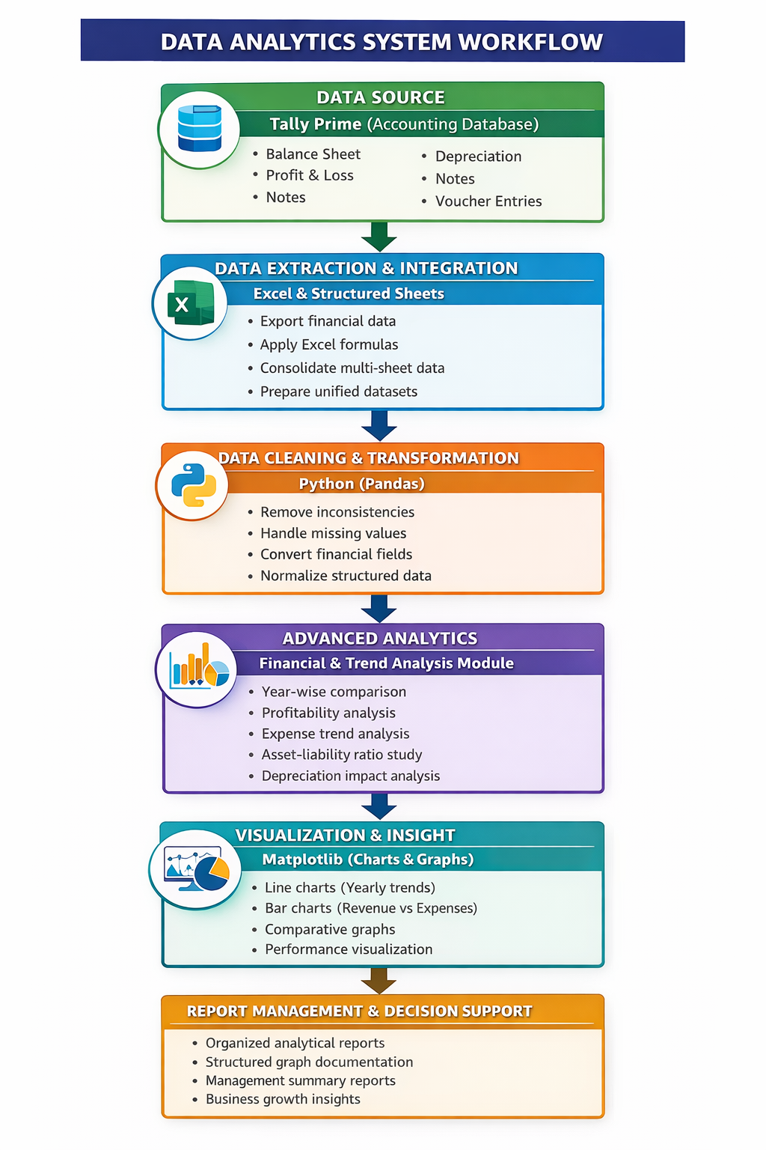
System Design
The system follows a multi-layer data analytics workflow for financial analysis in the tea plantation business.
Tally Prime acts as the primary accounting data source for financial records and statements.
Financial data is exported to Excel for organization and consolidation.
Python (Pandas) performs data cleaning, validation, and transformation.
The analytics layer conducts profitability, expense, asset–liability, and year-wise trend analysis.
Matplotlib generates charts and trend graphs for performance visualization.
The final layer organizes analytical reports and structured visual outputs for review and documentation.

Slide 15
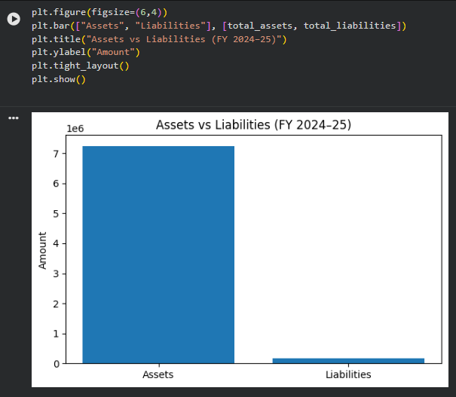
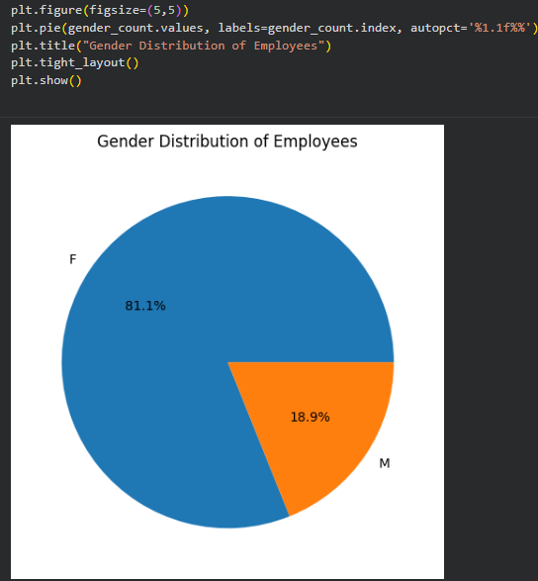
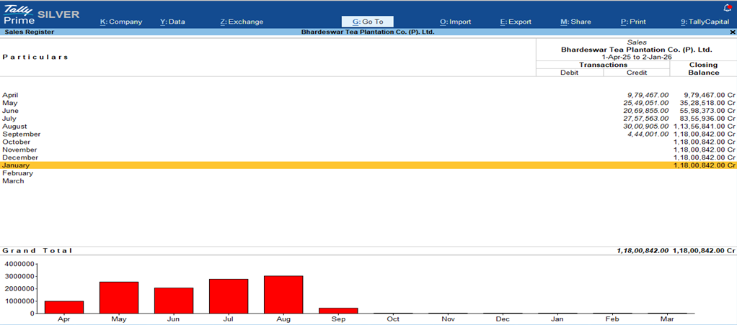
System Implementation
Financial data accessed and managed using Tally Prime.
Data exported to Excel for structuring and consolidation.
Excel formulas used for organizing and validating datasets.
Python (Pandas) used for data cleaning and transformation.
Financial analysis performed: profitability, expenses, asset–liability comparison.
Matplotlib used to generate charts and trend graphs.
Analytical outputs prepared as structured reports.

Slide 16
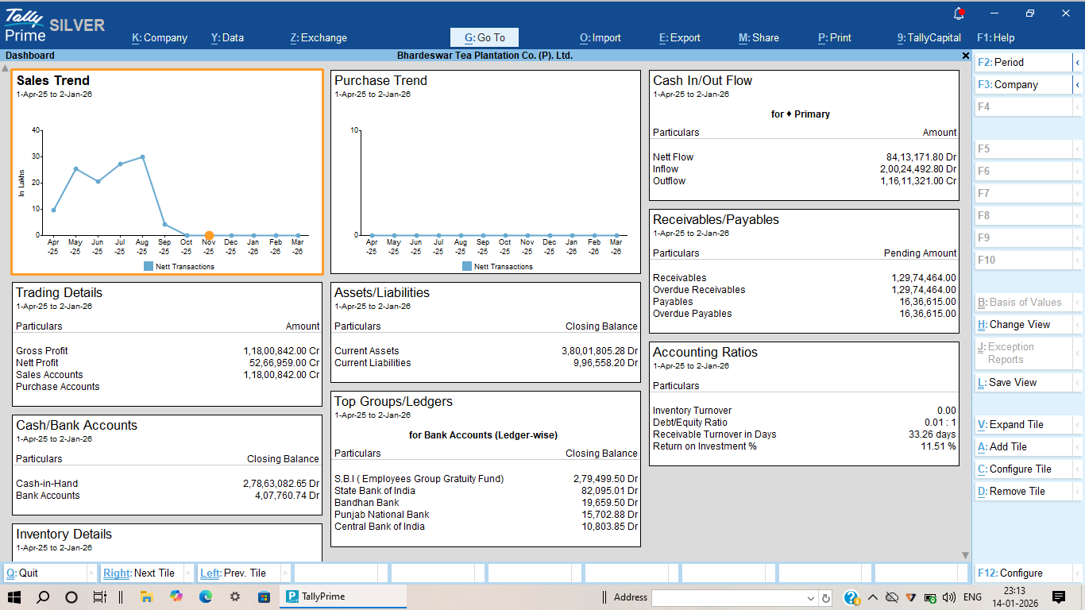
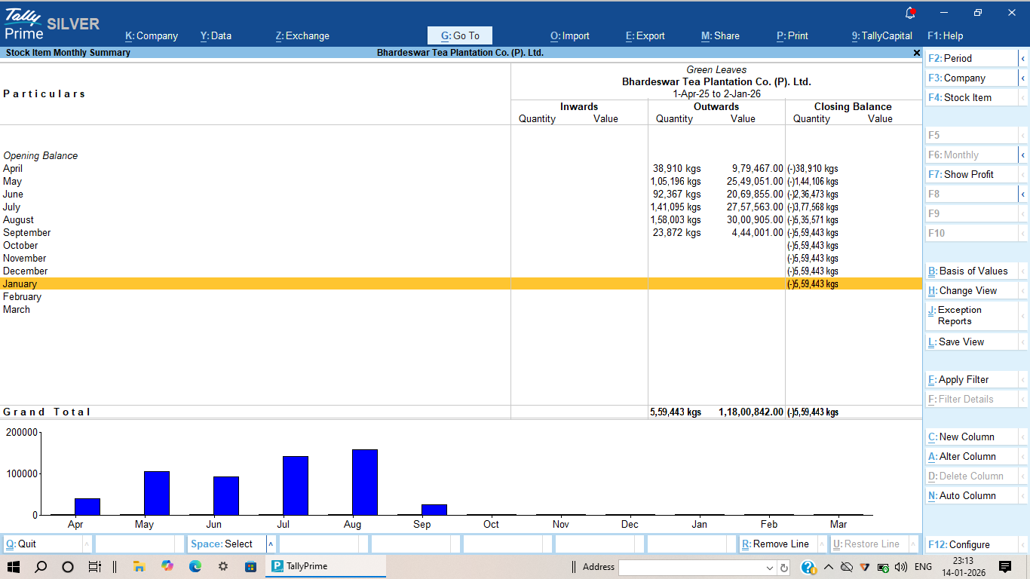
System Implementation

Slide 17
System Testing
System Testing
System testing was performed to evaluate the complete data analytics workflow
The system included data extraction from Tally, processing in Excel, and analysis using Python
Testing Activities:
Verified accuracy of financial data after extraction
Checked data cleaning (missing values, formatting issues)
Tested Python scripts for correct calculations and grouping
Validated charts and visual outputs
Key Observations:
Data flow between tools was smooth and error-free
Calculations such as profit and expenses were accurate
Visualizations clearly represented financial trends

Slide 18
Conclusion
This internship provided valuable hands-on experience in working with real-world financial and operational data within a tea plantation business environment. The project focused on transforming raw data into meaningful insights using tools like Excel and Python. Through this process, a structured workflow for data extraction, cleaning, analysis, and visualization was developed, highlighting the importance of data accuracy and proper processing in decision-making.
Key Takeaways:
Gained practical exposure to business data handling
Improved skills in data cleaning and analysis
Learned to use Python for generating insights and visualizations
Developed a systematic data processing workflow
Understood the role of analytics in business decision-making

Slide 19
References
Davenport, T. H., & Harris, J. G. (2007). Competing on Analytics: The New Science of Winning. Harvard Business School Press. https://hbr.org/2006/01/competing-on-analytics
McAfee, A., & Brynjolfsson, E. (2012). Big Data: The Management Revolution. Harvard Business Review, 90(10), 60–68.https://hbr.org/2012/10/big-data-the-management-revolution
McKinney, W. (2010). Data Structures for Statistical Computing in Python. Proceedings of the 9th Python in Science Conference.https://pandas.pydata.org/docs
Hunter, J. D. (2007). Matplotlib: A 2D Graphics Environment. Computing in Science & Engineering, 9(3), 90–95. https://matplotlib.org/stable/index.html
Kelleher, J. D., & Tierney, B. (2018). Data Science. MIT Press. https://mitpress.mit.edu/9780262535431/data-science/

Slide 20
References
Provost, F., & Fawcett, T. (2013). Data Science for Business. O’Reilly Media. https://www.oreilly.com/library/view/data-science-for/9781449374273/
Kimball, R., & Ross, M. (2013). The Data Warehouse Toolkit. Wiley. https://www.wiley.com/en-us/The+Data+Warehouse+Toolkit
NASSCOM (2022). SME Digital Adoption and Analytics Report. https://nasscom.in
Tea Board of India (2023). Annual Report on Tea Production and Industry Statistics.https://www.teaboard.gov.in
Witten, I. H., Frank, E., & Hall, M. A. (2016). Data Mining: Practical Machine Learning Tools and Techniques. Morgan Kaufmann. https://www.sciencedirect.com/book/9780128042915

Slide 21
Internship Road Map
Review 1
Training on tea plantation business domain, accounting workflow, and understanding data sources. Introduction to Tally, Excel, and basic reporting procedures.
Review 2
Review 3
Hands-on experience with Tally including sales, payment, receipt vouchers, and ledger maintenance. Support for audit-related data verification and record validation.
Review 4
Final Review
Data extraction from Tally to Excel. Data entry, data organization, and management of operational and financial datasets. Preparation of basic Excel reports and summaries.
Data cleaning, transformation, and structuring of datasets.
Creation of charts, dashboards, and trend analysis using Python for business reporting.
Presentation of overall learning and core data analytics work performed.
Explanation of data handling, reporting, visualization techniques, and key insights gained during the internship.

Slide 22
Github Link
https://github.com/Pre606/Data-Analysis-at-Bhardeswar-
Tea-Plantation-Company-Private-Limited-

Slide 23
Q&A

Slide 24
Thank you !!

